Slide 1

Data Analytics in Cyber Security (CT115-3-M)(Version E)
Machine Learning Methods
CT115-3-M-DACS
Machine Learning Methods
SLIDE 1

Slide 2
TOPIC LEARNING OUTCOMES
At the end of this topic, you should be able to:
Understand the differences between Artificial Intelligence (AI), Machine Learning (ML) and Deep Learning (DL).
Understand types of Machine Learning.
Understand characteristics of Deep Learning.
CT115-3-M-DACS
Machine Learning Methods
SLIDE 2

Slide 3

CONTENTS & STRUCTURE
Artificial Intelligence
Types of Machine Learning
Deep Learning
CT115-3-M-DACS
Machine Learning Methods
SLIDE 3

Slide 4
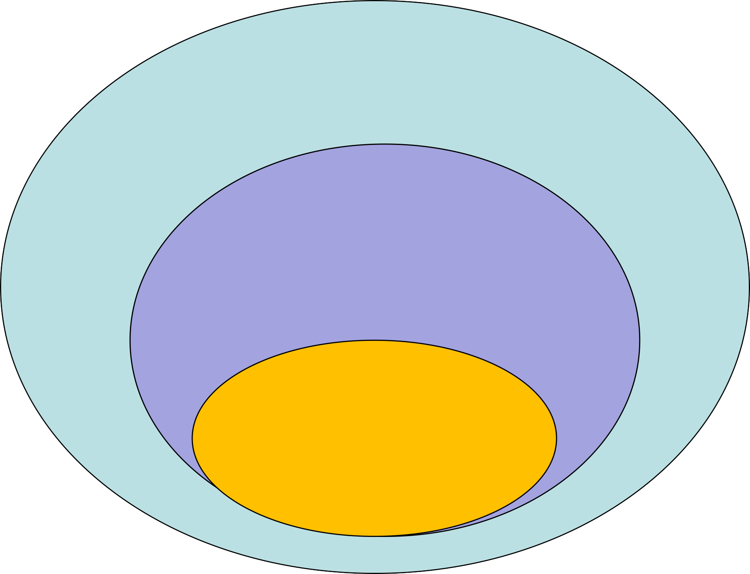
Artificial Intelligence (AI):
Mimicking the intelligence or behavioural pattern of humans or any other living entity.
Machine Learning (ML):
A technique by which a computer can use statistical patterns inferred from observation data to make predictions
Deep Learning (DL): A technique to perform machine learning inspired by the brain's network of neurons.

Slide 5
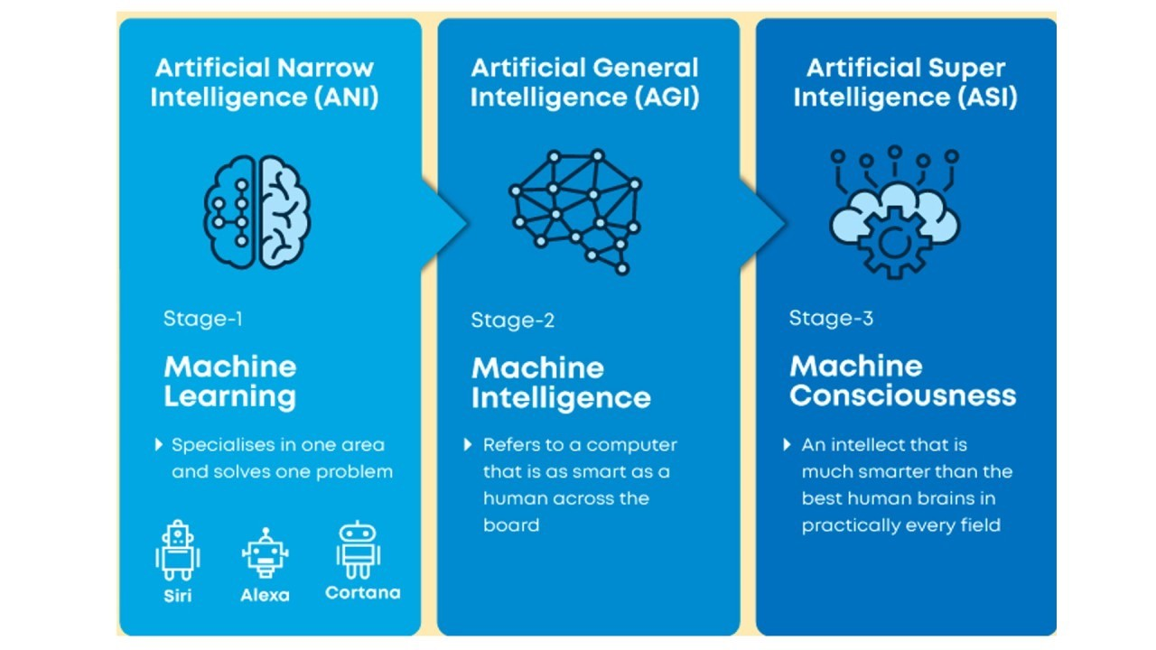

Slide 6
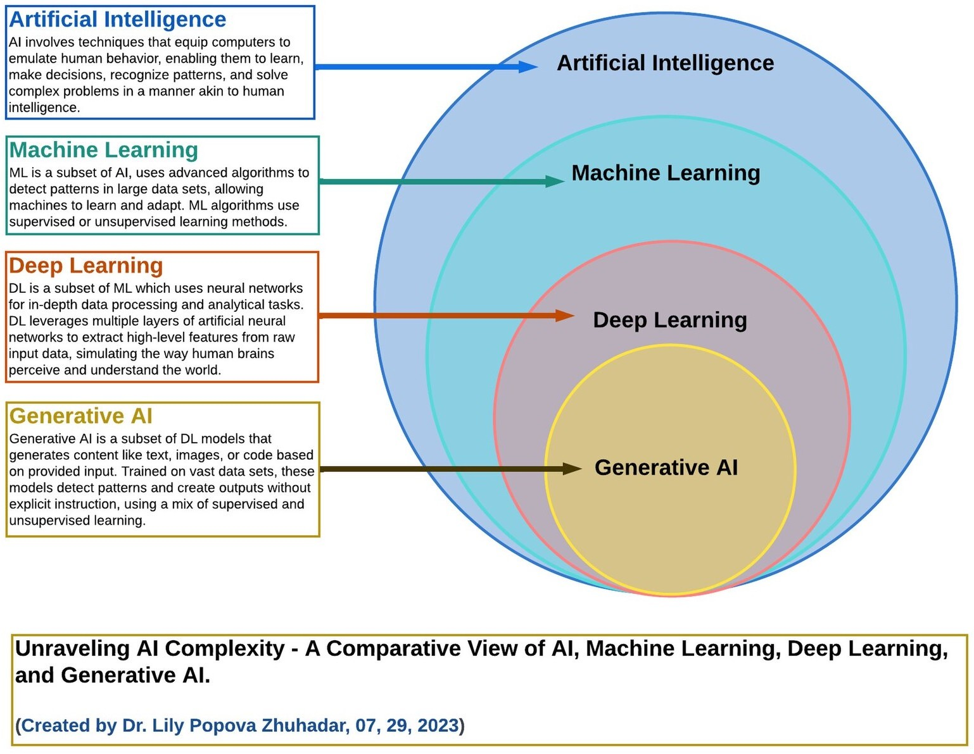

Slide 7
Artificial Intelligence (AI)
Artificial intelligence (AI) is a wide-ranging branch of computer science concerned with building smart machines capable of performing tasks that typically require human intelligence.
A science of making things smart or, in other words, human tasks performed by machines (e.g., visual recognition, understanding speech, etc.).

Slide 8
Machine Learning (ML)
An approach (one of many) to AI that uses a system that is capable of learning from experience (typically represented by data).
It is intended not only for AI goals (e.g., copying human behavior) but it can also reduce the efforts and/or time spent for both simple and difficult tasks.
ML is a system that can recognize patterns by using examples rather than by programming them.
The system “learns” patterns in the data using mathematical and statistical analysis.

Slide 9
Deep Learning (DL)
A set of techniques for implementing machine learning that recognise patterns of patterns.
For example, image recognition systems identify primary object edges, a structure, an object type, and then an object itself.
Deep Learning is using Deep Neural Networks (DNNs), which come in many forms. DNNs are an architecture, not an algorithm.

Slide 10
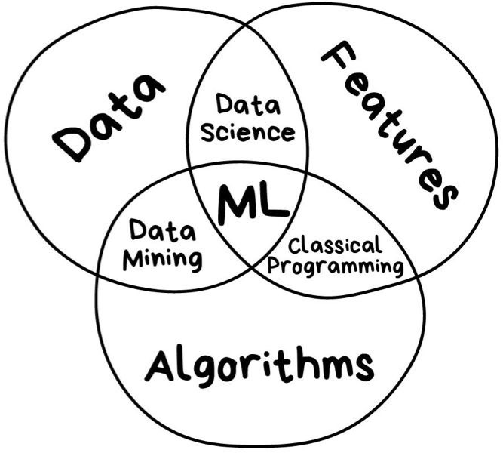
ML Algorithms
The main mathematical tools used by all ML algorithms are a blend of:
Linear algebra
Analytic geometry
Matrix decompositions
Vector calculations
Optimisation
Probability/Statistics

Slide 11
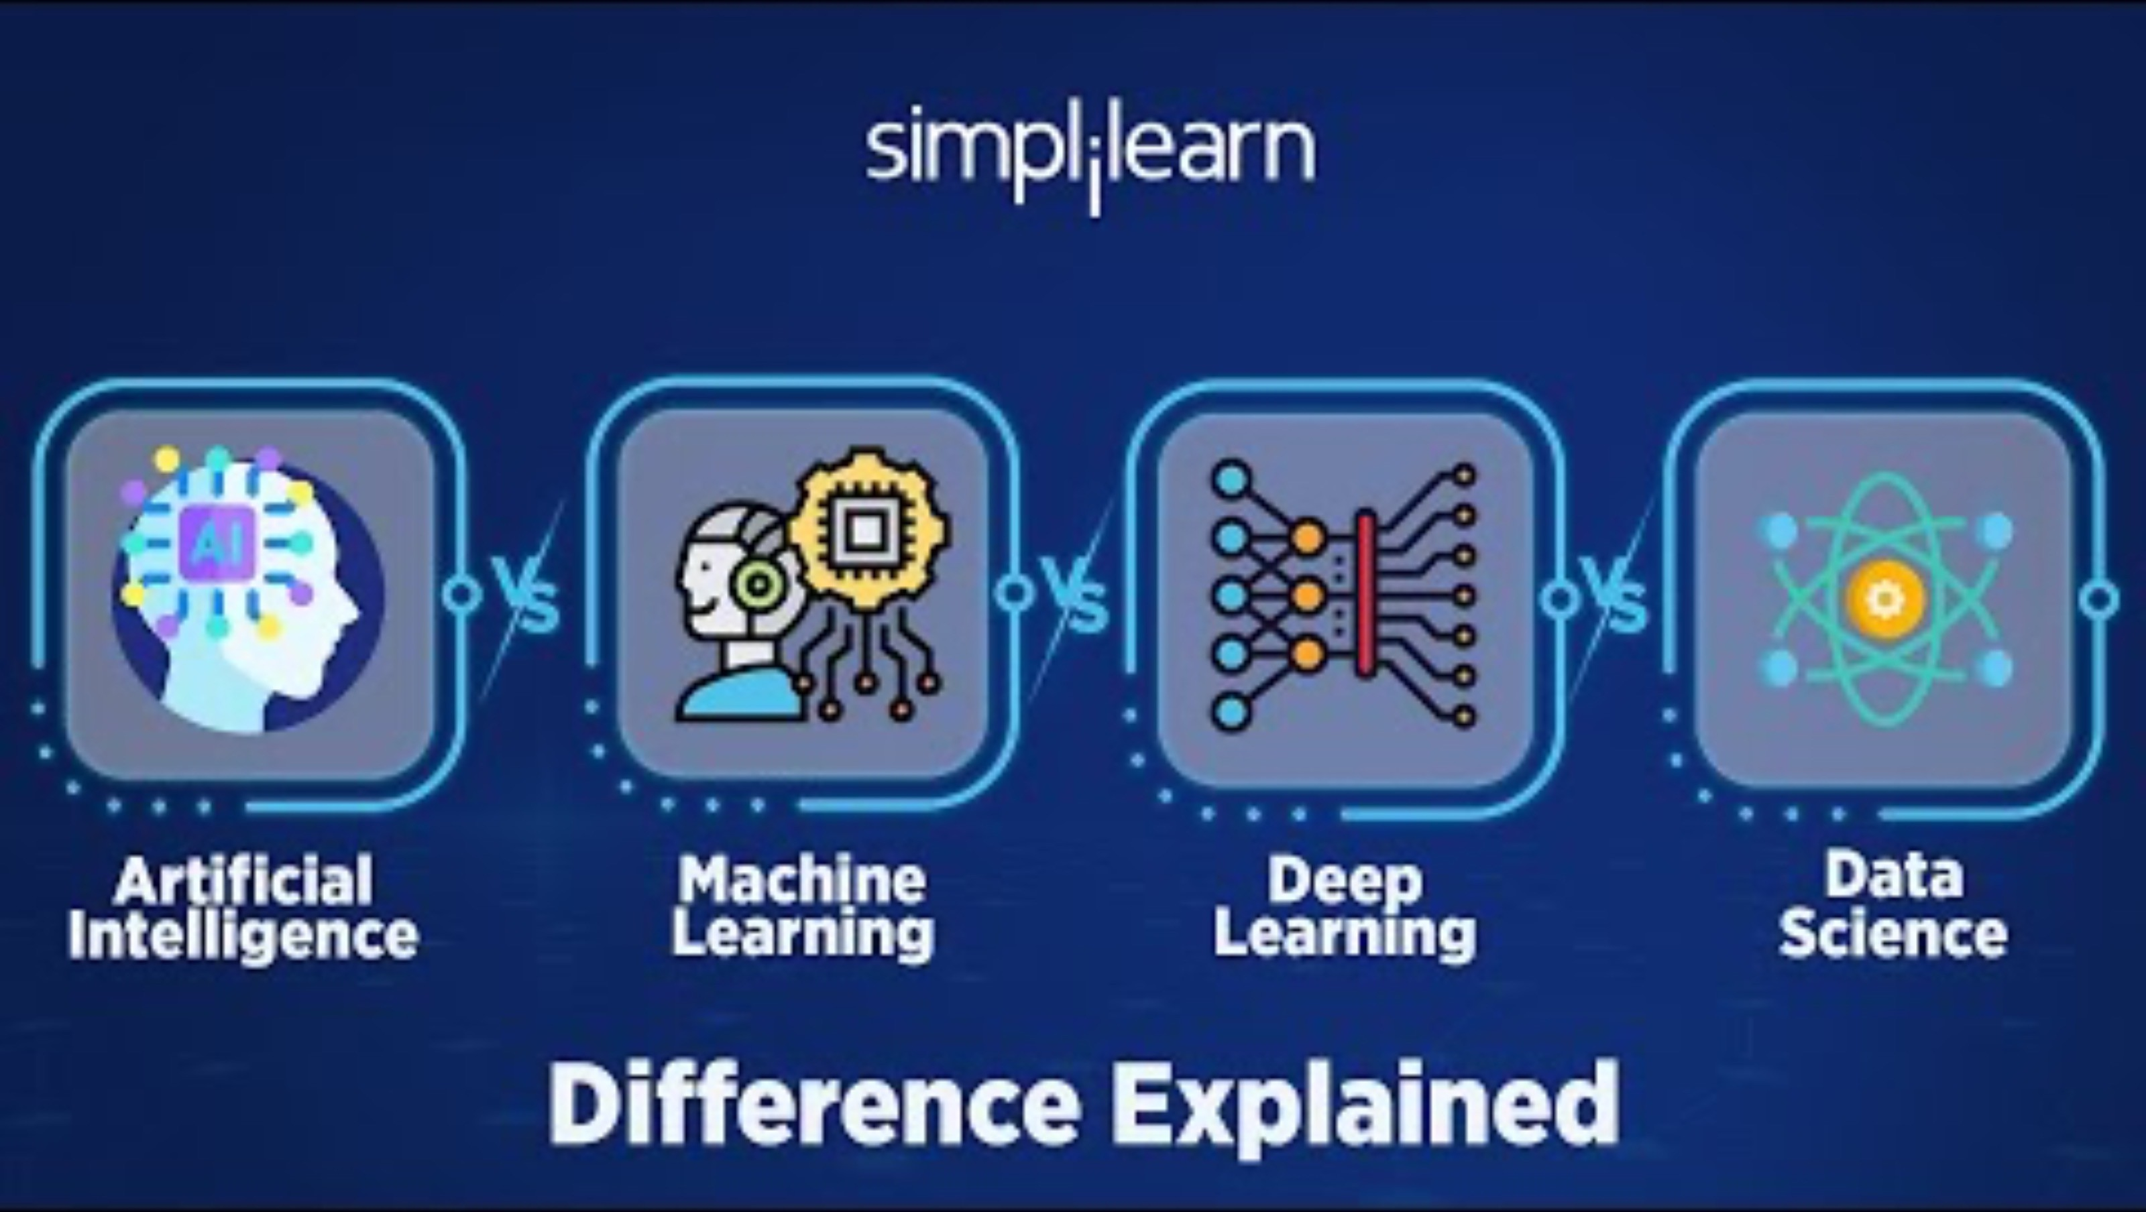
Difference between AI, ML and DL
https://www.youtube.com/watch?v=vNc2z2u_nh0

Slide 12
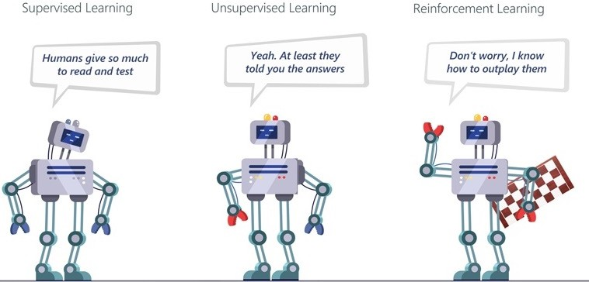
Types of Machine Learning
Machine learning is the ability of a machine to improve its performance based on previous results.

Slide 13
Types of Machine Learning
Supervised learning: The computer is presented with example inputs and their desired outputs, i.e., labelled data, given by a "teacher", and the goal is to learn a general rule that maps inputs to outputs.
  e.g., learn to recognise cars by images of cars and non-cars.
Unsupervised learning: no labels are given to the learning algorithm (i.e., unlabelled data), leaving it on its own to find structure in its input. Unsupervised learning can be a goal in itself (discovering hidden patterns in data) or a means towards an end.
  e.g., group toys of a given colour or shape from a Lego set.
Reinforcement learning: a computer program interacts with a dynamic environment in which it must perform a certain goal (such as driving a vehicle), without a teacher explicitly telling it whether it has come close to its goal or not, i.e., continuous reweighting of decision model elements after series of decisions.
  e.g., learn to play tennis / table tennis.

Slide 14
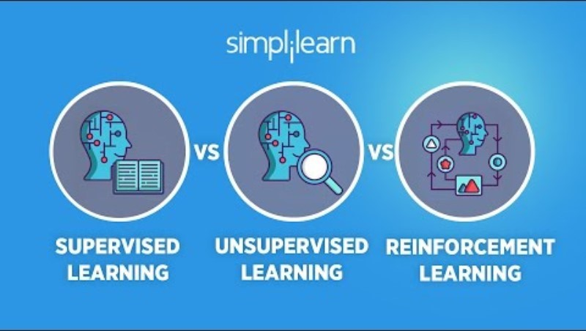
Types of Machine Learning
https://www.youtube.com/watch?v=1FZ0A1QCMWc&t=1s

Slide 15
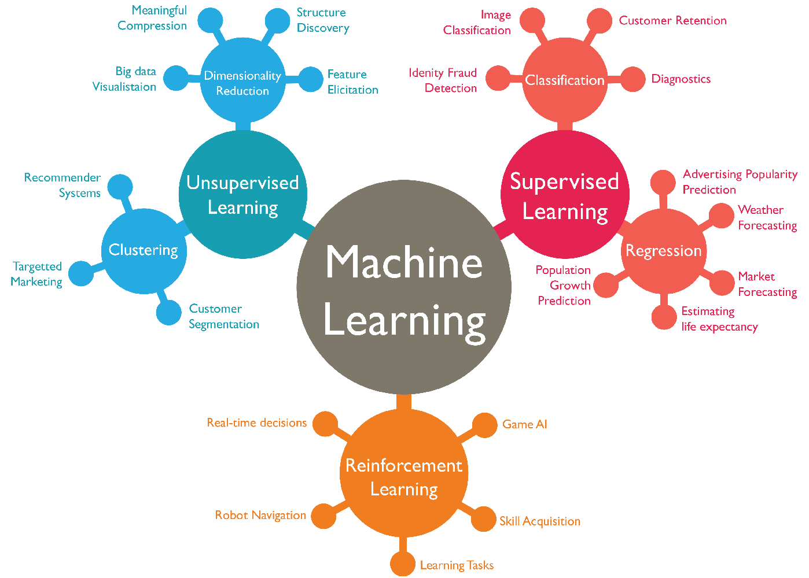
Machine Learning

Slide 16

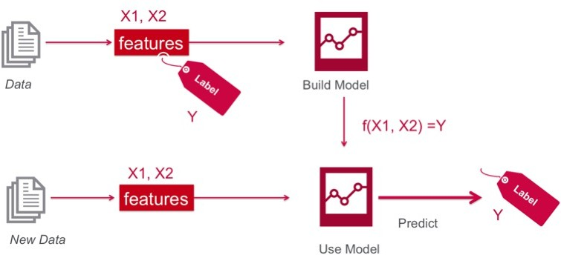
Supervised Learning
That’s nice – but where do the labels come from?

Slide 17

Supervised Learning
The labels come from human intelligence
X: Attributes (Features, Descriptors)
Labeled example / Concept
BP | T | A | G | S | y
: | : | : | : | : | H H NH H NH NH H
: | : | : | : | :
: | : | : | : | :
: | : | : | : | :
: | : | : | : | :
: | : | : | : | :
: | : | : | : | :
: | : | : | : | :
x
y (Label)
Learning “Healthy” Concept
H: Healthy
NH: Not healthy
BP: Blood pressure T: Temperature
A: Age
G: Gender S: Smoking
Supervisor

Slide 18
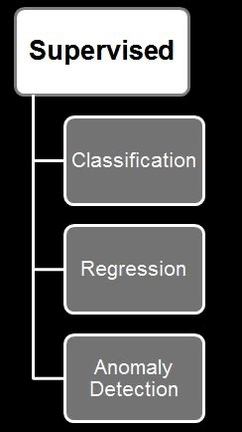
Supervised Learning – Types of Problems
Supervised Methods (also called Predictive): Predict an unknown value(s) of a variable(s) from the values of some attributes
Classification: predict the type/class of new cases
  Spam Filtering, Handwriting Character Recognition,
Patient Diagnosis
Regression: predict a numerical value of new cases
  Blood Pressure, Sales Amounts
Supervised Anomaly Detection: identify items, events or observations deviating from expected patterns using data labeled as "normal" and "abnormal" (involves training a classifier)
It is common to combine different methods such as clustering and classification (Hybrid methods)

Slide 19
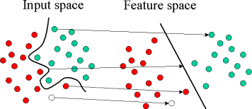
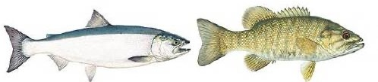
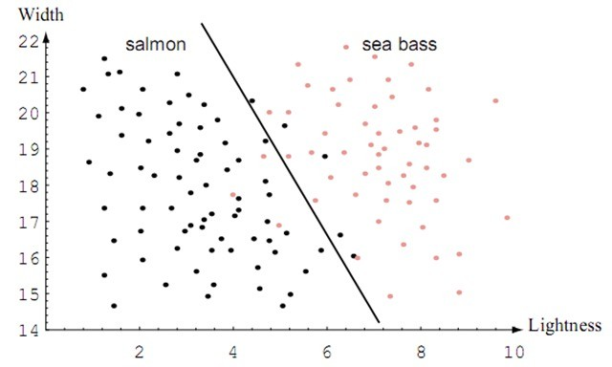
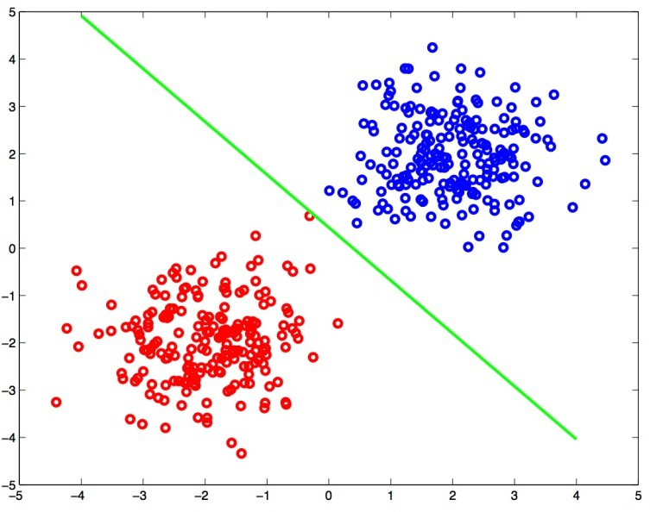
Classification
Extracting features from given inputs allows us to separate and classify the inputs according to defined categories

Slide 20
Example: Recognizing Five Letters
A, B, C, D, E
Example features:
Straight strokes
4_{E}
³A D
2
B
x: Number of curved segments
y: Number of straight segments
Where would “F” fall?
1
Curved strokes
3
C
Suggest an additional feature
0
0
1
2

Slide 21

Handwriting Recognition
Requires dealing with many variants of characters

Slide 22

Features: Comparing Fingerprints
Criminal investigations and biometric identification
Does a fingerprint match any of the prints in a criminal database? Does the fingerprint match one recorded for an authorized user?
Human fingerprints tend to be unique
Even identical twins have different prints
http://www.youtube.com/watch?v=IrpTqKkgygA [6min]

Slide 23
Machine Learning

Slide 24
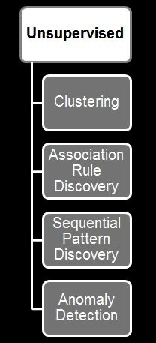
Unsupervised Learning – Types of Problems
Unsupervised Methods (also called Descriptive): Try to find meaningful patterns in the data.
  Clustering: group similar data into clusters
    Market Segmentation, Document Clustering
  Association Rule Discovery: find human interpretable patterns (associations)
    Product Recommendations, Store Shelf Management
  Sequential Pattern Discovery: describe the sequential dependencies among different events
    Buying Patterns, Gene Sequencing
  Unsupervised anomaly detection: to detect anomalies in unlabeled data under the assumption that the majority of the instances are normal
    Fraud Detection, Network Intrusion Detection

Slide 25
Unsupervised: Clustering
Clustering is similar to classification with the only but major difference. The information about the classes of the data is unknown. There is no idea whether this data can be classified.
Usually clustering is not applied to solving a particular task in cybersecurity as it is more like one of the subtasks in a pipeline (e.g., grouping users into separate groups to adjust risk values).

Slide 26
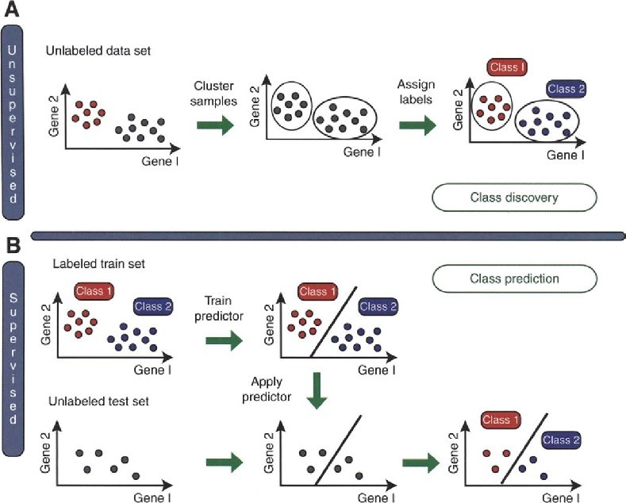
Unsupervised vs. Supervised

Slide 27
Machine Learning

Slide 28
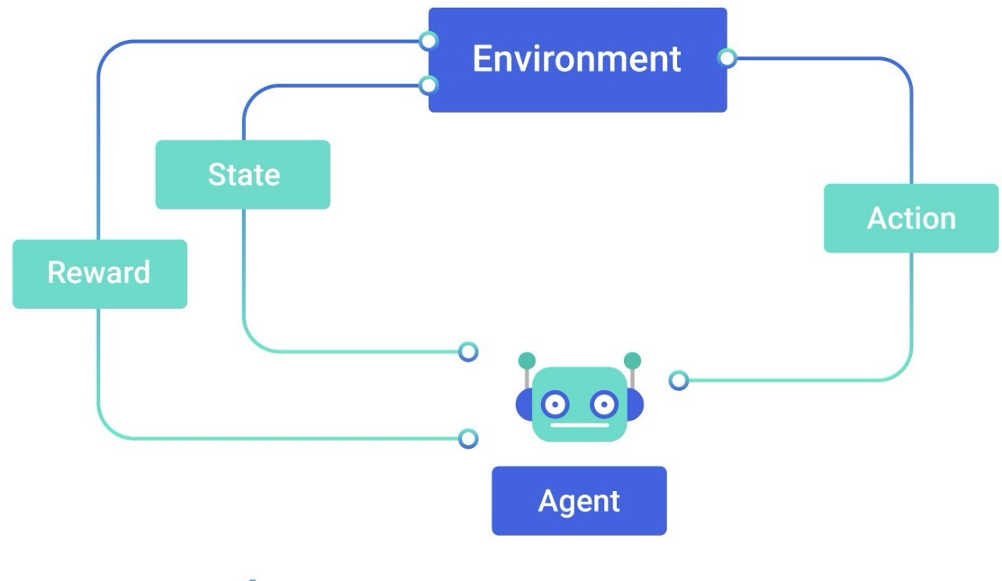
Reinforcement learning – Types of Problems
Reinforcement learning is a machine-learning training method based on rewarding desired behaviors and/or punishing undesired ones. In general, a reinforcement learning agent is able to perceive and interpret its environment, take actions and learn through trial and error.
Action (for example) Robot movement Characters in games Autonomous car driving

Slide 29

Reinforcement learning
https://www.youtube.com/watch?v=nIgIv4IfJ6s&t=1s

Slide 30
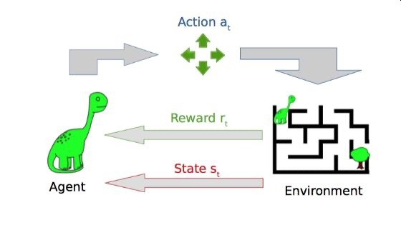
Reinforcement learning
https://www.theverge.com/tldr/2017/7/10/15946542/deep mind-parkour-agent-reinforcement-learning
https://video.twimg.com/ext_tw_video/1111683489890332 672/pu/vid/1200x674/WqUJEhUETw0M0gCl.mp4?tag=8

Slide 31
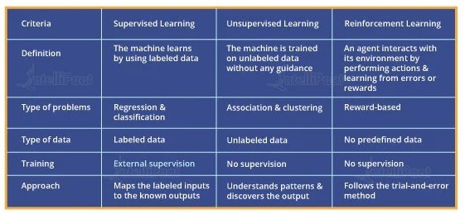
Supervised vs Unsupervised vs Reinforcement

Slide 32
Artificial Intelligence:
Mimicking the intelligence or behavioural pattern of humans or any other living entity.
Machine Learning:
A technique by which a computer can use statistical patterns inferred from observation data to make predictions
Deep Learning: A technique to perform machine
learning inspired by the brain's network of neurons.

Slide 33

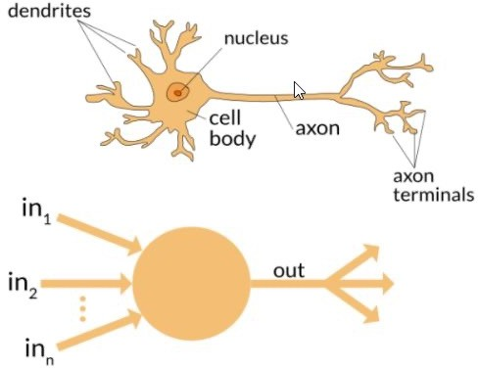
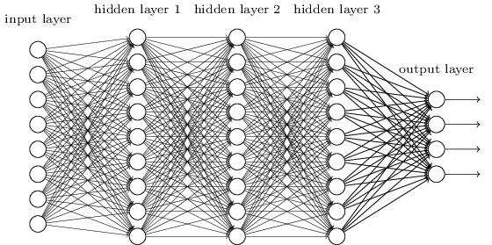
Deep Learning
Deep learning is a system architecture, not an algorithm
a style of parallel computation inspired by neurons and their adaptive connections: It’s a very different style from a sequential computation.

Slide 34
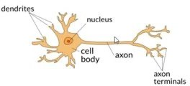

Artificial Neural Network
ANN is a machine learning approach inspired by the way in which the brain performs a particular learning task
ANN has several “neurons” interconnected (architecture)
Knowledge about the learning task is stored as inter neuron connection strengths (weights)
During the learning process the weights are modified in order to model the particular learning task correctly on the training examples.

Slide 35
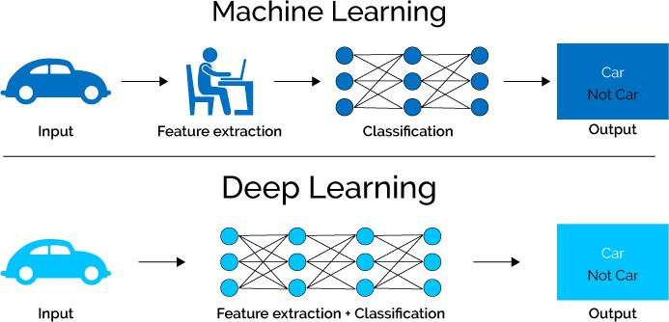
Deep Learning
Deep learning methods aim at learning feature hierarchies where features from higher levels of the hierarchy are formed from the lower-level features.
  The Model Defines the Features

Slide 36
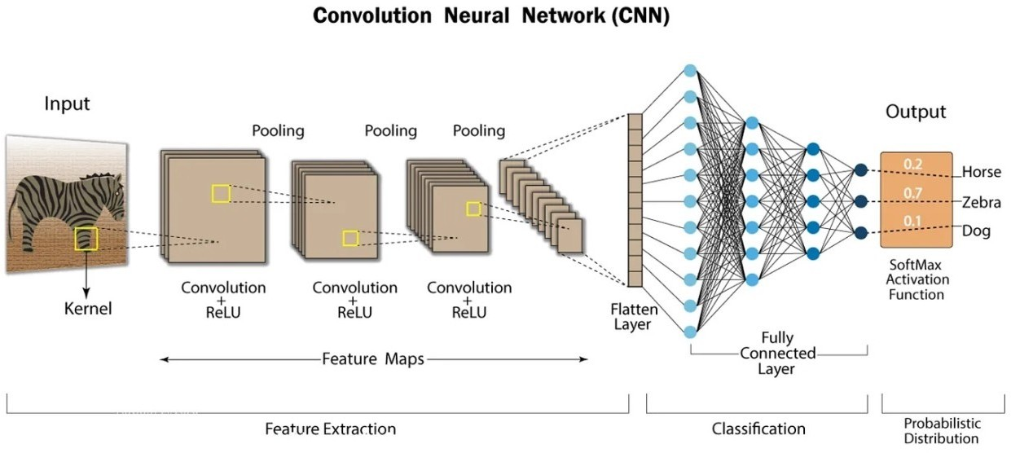
Deep Learning

Slide 37
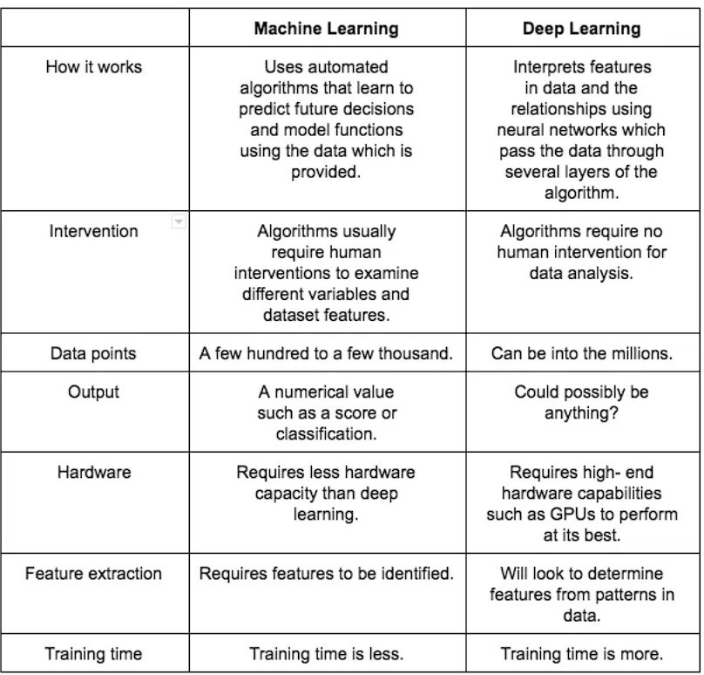
Machine Learning v. Deep Learning

Slide 38
Current Limits
DNNs consist of multiple layers of interconnected neurons. Each neuron and layer contributes towards the task that the network has been trained to execute.
However, scalability and generalisation is not simple.
The behaviour of a NN changes with the amount of data, and it also depends on methods of training and network architecture.
– you can’t just feed 10x more data to a NN and expect it to become 10x more precise.
Must experiment with network structures and training modes for the technology to be usable.
This has led to a LOT of variations of DNN architectures

Slide 39
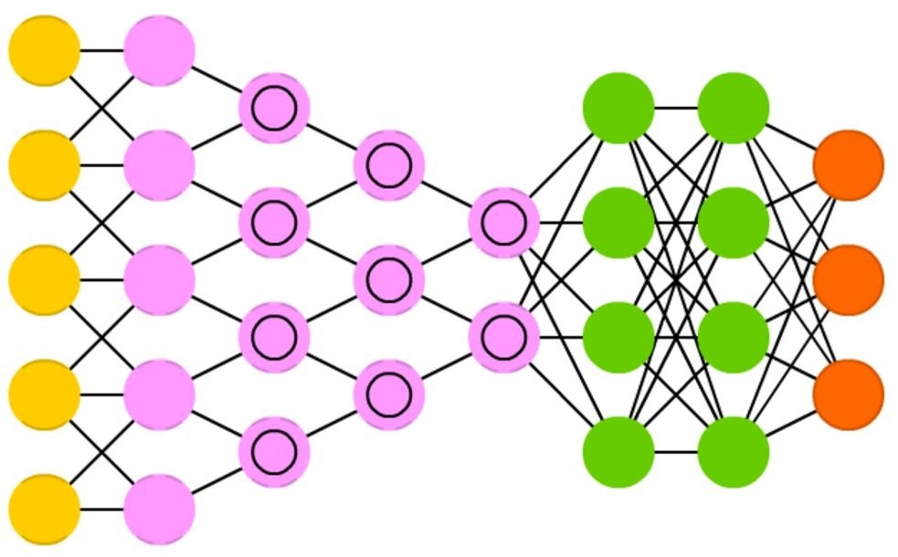
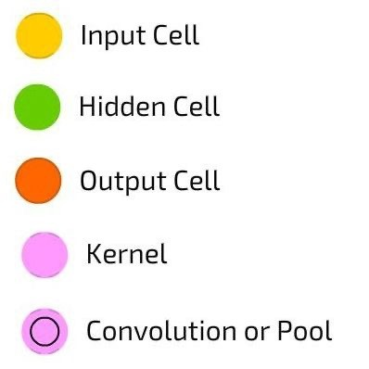
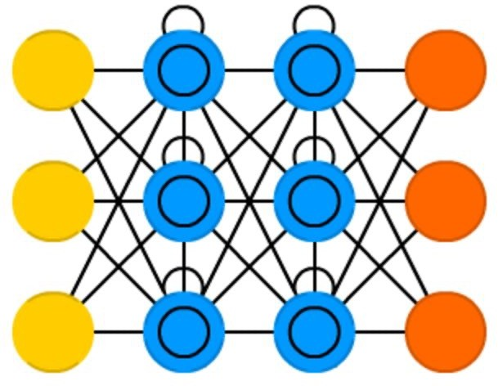
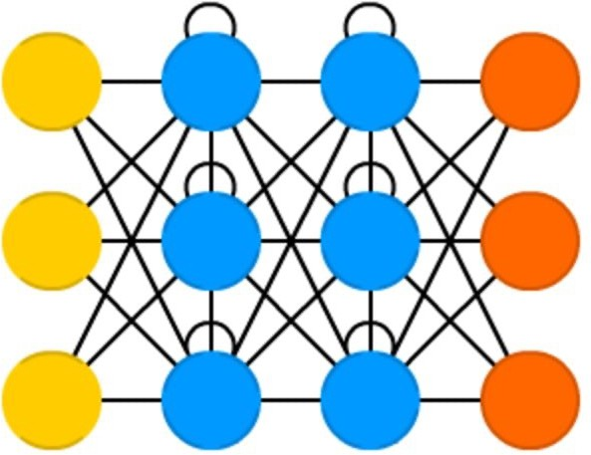
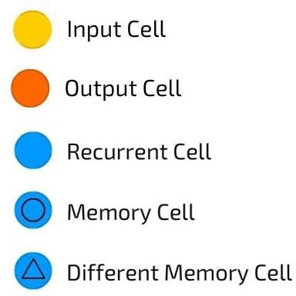
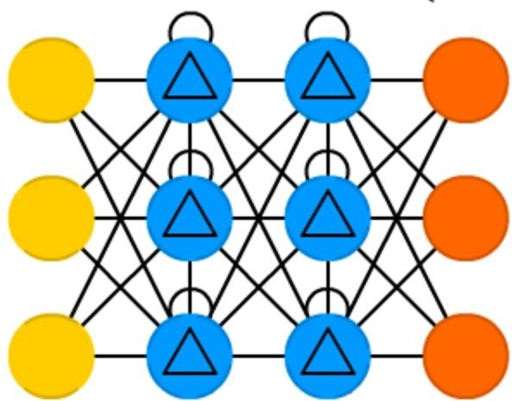
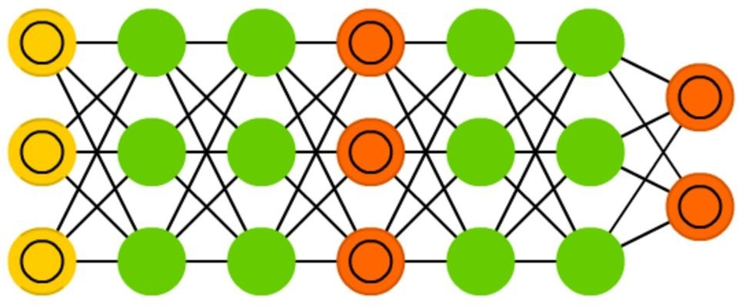
CNN
LSTM
RNN
GRU
GAN
https://towardsdatascience.com/the-mostly-complete-chart-of-neural-networks-explained-3fb6f2367464

Slide 40
Hardware is Important
Training a neural network is a compute-intensive process
DNNs require a large amount of training data to achieve high accuracy, meaning hundreds of thousands of input samples
State-of-the-art DNNs can have well over one billion parameters to adjust
Requires multiple forward passes for error detection, and multiple backward passes of adjusting the weights of millions of neurons in various layers of the network.

Slide 41
Hardware is Important
Because neural networks are created from large numbers of identical neurons, they are highly parallel by nature.
This parallelism maps naturally to GPUs, which provide a significant speedup over CPU-only training.
Neural networks rely heavily on matrix math operations and require tremendous amounts of floating-point performance and bandwidth for both efficiency and speed.
GPUs have thousands of processing cores optimized for matrix math operations

Slide 42
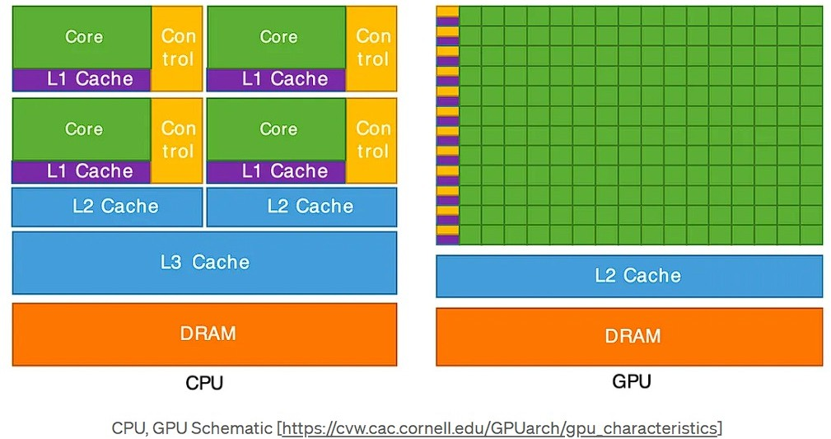
CPU vs. GPU Architecture
Small number of powerful cores
Very large number of simple stream
processors
versus

Slide 43
Review Questions
What are the differences between AI, ML and DL?
What are different types of Machine Learning?
What are the typical characteristics of Deep Learning?
CT115-3-M-DACS
Machine Learning Methods
SLIDE 43

Slide 44
Summary / Recap of Main Points
The differences between AI, ML and DL.
Types of Machine Learning.
Characteristics of Deep Learning.
CT115-3-M-DACS
Machine Learning Methods
SLIDE 44

